Slide 1
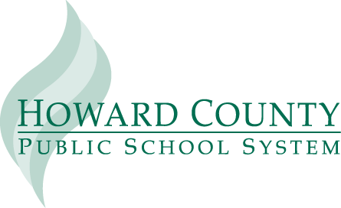
Why the Common Core Standards?
The standards are the result of a national movement to provide an equitable, coherent, focused, and rigorous curriculum.
The standards will enable our students to be college and career ready in order to compete globally.

Slide 2
Why Grades 3, 4 and 5 in 2013-2014?
Maryland adopted the Common Core in 2011 and will begin assessing those standards during the 2014-2015 school year.
HCPSS started the transition two years ago with kindergarten and implemented the CCSS in grades 1&2 last school year.
The transition continues this year in grades 3, 4 and 5. Therefore, all students will be prepared for new assessments the following year in 2014-2015.

Slide 3
What Will Our Students Learn?
Grade 3
Problem Solving and Application
Place Value
Addition/Subtraction
Multiplication/Division including Fact Fluency
Fractions
Time
Area and Perimeter
Attributes of shapes

Slide 4
What Will Our Students Learn?
Grade 4
Problem Solving and Application
Place Value
Addition/Subtraction
Multiplication/Division
Fractions
Decimals
Area/Perimeter
Geometric lines and angles

Slide 5
What Will Our Students Learn?
Grade 5
Problem Solving and Application
Decimals
Multiplication/Division
Fractions
Volume Measurement
Quadrilaterals and Coordinate Grids
Numerical Expressions

Slide 6
What Will Our Students Learn?
Grade 5- Above Grade Level Curriculum
Problem Solving and Application
Division
Decimals and Fractions
Integers
Ratio and Proportion
Expressions and Equations
Area and Volume
Statistics and Probability

Slide 7
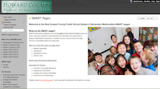
Where Can I Get More Information?
HCPSS SMART Pages
More information about the Common Core State Standards
Specific grade level standards
Optional activities you can do at home to support your student
http://smart.hcpss.wikispaces.net

