Slide 1
Class Dojo
Use that Mojo to Earn that Dojo!

Slide 2
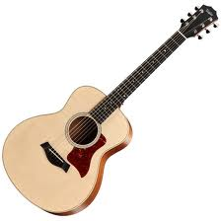
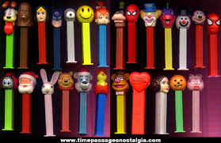
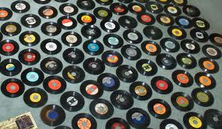
About Me!

Slide 3
What is Class Dojo?
Class Dojo is an app that helps us become better learners.
We use it to help us follow FRES to become better students.
In class Dojo you can earn and lose points based on how well you follow FRES!

Slide 4
The Avatar
Each student has an electronic monster called an avatar.
You can personalize it or make it how you like at home.

Slide 5
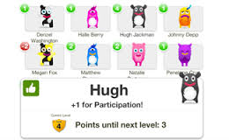
Positive Points
Mr. White will give out points when he sees you show FRES or the positive behaviors.
The more points you have the more prizes you can get!
I can give points to one, a group, or the whole class!

Slide 6
The Positives
Clean and Tidy
Completes Work
Eyes on Teacher
Helping Others
Homework
Inside Voices
Kind Manners

Slide 7
The Positives
Line up
Hallway
On Task
Participation
Raise Your Hand
Teamwork
Unpack/Pack up
Working Hard

Slide 8
Needs Work
Breaking Procedures
Bullying
Disrespect
Hands to Self
Loud Voices
Messy Area
No Homework

Slide 9
Needs Work
Off Task
Out of Seat
Talking Out of Turn
Unprepared

Slide 10
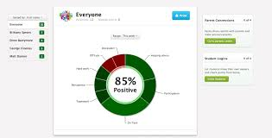
The Percentage
Each Week you will get a percentage that your parents can keep track of throughout the week.

Slide 11
Percentage Pages
Percentage Pages will be sent home in your Thursday Folders.
They are to be signed and brought back to school the following day.

Slide 12
The Dojo Journal
Each student will receive a Dojo Journal to keep track of your points.
At the end of each day you will graph your points.

Slide 13
Friday Goal Setting
Each Friday you AND the class will set a goal for the following week.
I know everyone will reach their goals!
Why do we set goals and how do we meet them?

Slide 14
3 Needs Work
If a student gets 3 needs work a Dojo communication form will be sent home and a note in your agenda book.

Slide 15
Dojo Prize Board
What do we want to put on the prize board??

Slide 16
The Top Three
The Top Three Dojo Point Leaders will be able to choose out of my prize bin.
If you are not on the top three you can still use your spend your points based on the Dojo Prize Board.

Slide 17
Procedure Points
Procedure Points are guaranteed Dojo points if you follow the procedure.
Easy Peasey Lemon Squeezey!

Slide 18
Procedures
Unpack
Pledges
Line up
Coming into the Class
Homework
Hallway

Slide 19
Procedures
Coming in from RA
Coming in From Math
Coming in From Lunch
Switching During Reading Rotations
Pack up
These will be listed in the classroom

Slide 20
Questions?
Any Questions?
Lets Practice A Goal Setting Sheet
Time to decorate our journals!

