Slide 1
Understanding the Next Generation Science Standards (NGSS)
Fourth Grade

Slide 2
Key Shifts
K-12 science education should focus on BOTH content and skill, so that students know how to apply their factual knowledge.
Science and engineering are integrated in the NGSS from Kindergarten through Twelve Grade.
The NGSS were specifically designed to prepare students for college, careers, and citizenship.
NGSS Lead States. 2013. Next Generation Science Standards: For States, By States. Appendix A: Conceptual Shifts in the Next Generation Science Standards. Washington, DC: The National Academies Press. Link

Slide 3
Key Shifts
The NGSS are aligned with the Maryland College and Career Readiness ELA and Mathematics Standards.
The NGSS were purposefully created based on research, by an extensive group - across 26 states - of practicing scientists, brain research professionals, science education researchers, educators, policy experts, and were even released to the public for review and revision.
NGSS Lead States. 2013. Next Generation Science Standards: For States, By States. Appendix A: Conceptual Shifts in the Next Generation Science Standards. Washington, DC: The National Academies Press. Link
Notes:
The National Resource Council (NRC), began by developing the A Framework for K–12 Science Education, which was released in July 2011
The Framework is grounded in the most current research on science and science learning and identified the science all K–12 students should know.
To write the Framework, the NRC formed a committee and four topic design teams made up of members nationally and internationally known in their respective fields, including practicing scientists, cognitive scientists, science education researchers, and science education standards and policy experts.
A public draft was released in July of 2010. The NRC reviewed comments and considered all feedback prior to releasing the final Framework on July 19, 2011.
In a process managed by Achieve, 26 lead states (including Maryland) contributed to the development of K-12 Next Generation Science Standards (NGSS)
The NGSS were developed collaboratively between these states and other stakeholders in science, science education, higher education and industry.
As part of the development process, the standards underwent multiple reviews from many stakeholders including two public drafts, allowing all who have a stake in science education an opportunity to inform the development of the standards.
The standards were published in April 2013. (standards are NOT curriculum)
During the summer of 2013, the Elementary Science Office and HCPSS teachers began generating curriculum; creating lessons and materials that align with NGSS.
http://www.nextgenscience.org/development-overview
Currently, in the 2014-2015 school year, all Kindergarten and Third Grade teachers are delivering NGSS aligned instruction.
There are 4, First Grade teams of HCPSS teachers that are piloting new NGSS aligned material written during the summers of 2013 and 2014.
There are 5, Fourth grade teams within county schools that are piloting the new material written.
2nd and 5th grade teachers are focusing on enhancing existing essential curriculum for science with instruction that encourages the 8 Scientific and Engineering Practices (see next slide)

Slide 4
2014 - 2015 As we implement…
We want to focus on
Scientific and Engineering Practices
Asking Questions (for science) and defining problems (for engineering)
Developing and using models
Planning and carrying out investigations
Analyzing and interpreting data
Using mathematics and computational thinking
Constructing explanations (for science) and
designing solutions (for engineering)
Engaging in argument from evidence
Obtaining, evaluating, and communicating information
Notes:
The NGSS aligned curriculum developed by HCPSS was created with the intention to encourage student-centered instruction, with a focus on inquiry. The teacher, acting in the role of facilitator, delivers instruction infused with these 8 Practices so that students may learn not only the content knowledge, but also the behaviors and skills that that lead to success in the science and engineering career fields. In this way, the NGSS aligned curriculum supports HCPSS Vision 2018, by creating an engaging and vibrant learning environment in which every student is inspired to learn and empowered to excel.
A Framework for K-12 Science Education outlines three dimensions to science education:
Scientific and Engineering Practices (behaviors and habits of mind)
Crosscutting Concepts (unifying themes)
Disciplinary Core Ideas (big ideas, or topics)
The three dimensions work together like a braided rope in order to create instruction that is authentic and applicable for students.
The 8 Scientific and Engineering Practices describe the behaviors and habits of mind that are necessary to make students’ knowledge of content (Core Ideas) more meaningful.
The term “practices,” instead of a term such as “skills,” is used to stress that engaging in scientific inquiry and engineering design requires coordination both of knowledge and skill simultaneously.
Acquiring skills in these practices supports a better understanding of how scientific knowledge is produced and how engineering solutions are developed.
Such understanding will help students become more critical consumers of scientific information.

Slide 5
Fourth Grade: Quarter 1
Energy
Use evidence to construct an explanation relating the speed of an object to the energy of that object.
Make observations to provide evidence that energy can be transferred from place to place by sound, light, heat, and electrical currents.
Ask questions and predict outcomes about the changes in energy that occur when objects collide.
Apply scientific ideas to design, test, and refine a device that converts energy from one form to another
Obtain and combine information to describe that energy and fuels are derived from natural resources and that their uses affect the environment.
Notes:
The bullets are the Performance Expectations from the Topical Arrangement of the grade-level NGSS.

Slide 6
Fourth Grade: Quarter 2
Waves
Develop a model of waves to describe patterns in terms of amplitude and wavelength and that waves can cause objects to move
Generate and compare multiple solutions that use patterns to transfer information
Notes:
The bullets are the Performance Expectations from the Topical Arrangement of the grade-level NGSS.

Slide 7
Fourth Grade: Quarter 3
Structure, Function, and Information Processing
Develop a model to describe that light reflecting from objects and entering the eyes allows objects to be seen.
Construct an argument that plants and animals have internal and external structures that function to support survival, growth, behavior, and reproduction.
Use a model to describe that animals receive different types of information through their senses, process the information in their brain, and respond to the information in different ways.
Notes:
The bullets are the Performance Expectations from the Topical Arrangement of the grade-level NGSS.

Slide 8
Fourth Grade: Quarter 4
Earth’s Systems: Processes That Shape the Earth
Identify evidence from patterns in rock formations and fossils in rock layers to support an explanation for changes in a landscape over time.
Make observations and/or measurements to provide evidence of the effects of weathering, or the rate of erosion by water, ice, wind, or vegetation.
Analyze and interpret data from maps to describe patterns of Earth’s features.
Generate and compare multiple solutions to reduce the impacts of earthquakes on humans.
Notes:
The bullets are the Performance Expectations from the Topical Arrangement of the grade-level NGSS.

Slide 9
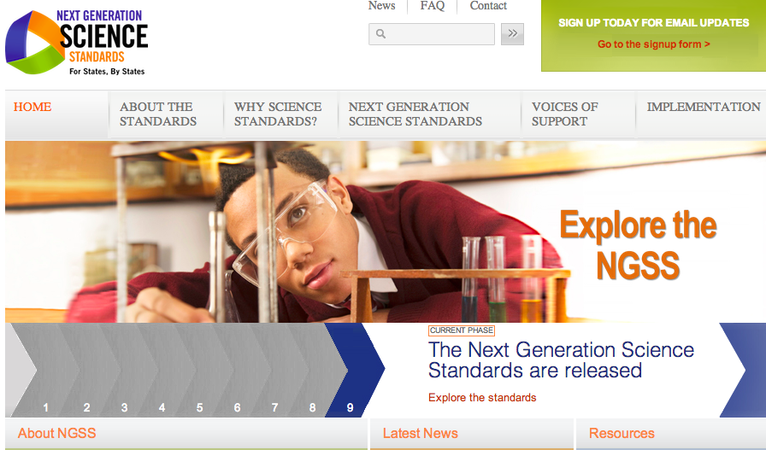
For more information:
http://www.nextgenscience.org/

